Slide 1
Specifications & Legislation
Michael A. Caruso
HEMP /IEMI Facility Design
U.S. Congress:
H.R.3410 (Critical Infrastructure Protection Act) (CIPA)
CIPA directs and empowers the Department of Homeland Security to harden and protect our critical infrastructure including power production, generation, and distribution systems.
To Amend The Homeland Security Act of 2002 To Secure Critical Infrastructure Against Electromagnetic Pulses, And For Other Purposes
October 30, 2013
Referred to the Subcommittee on Cybersecurity, Infrastructure Protection, and Security Technologies

Slide 2
Specifications & Legislation
Michael A. Caruso
HEMP /IEMI Facility Design
U.S. Congress:
H.R.3410 (Critical Infrastructure Protection Act) (CIPA)
12/01/2014 Passed/agreed to in House
12/02/2014 Received in the Senate and Read twice and referred to the Committee on Homeland Security and Governmental Affairs.
Rejected by Senate, Died in Committee
Reintroduced as H.R.1073 – CIPA Rep. Franks

Slide 3
Specifications & Legislation
Michael A. Caruso
HEMP /IEMI Facility Design
U.S. Congress:
H.R.1073 – CIPA Rep. Franks, Trent [R-AZ-8] (Introduced 02/25/2015)
House - Homeland Security | Senate - Homeland Security and Governmental Affairs. Committee Reports: H. Rept. 114-240
June 25, 2015 Passed Committee on Homeland Security
S. 1846 Critical Infrastructure Protection Act of 2015
As ordered reported by the Senate Committee on Homeland Security and Governmental Affairs on July 29, 2015
S.1846: 11/17/2015 Received in the Senate and Read twice and referred to the Committee on Homeland Security and Governmental Affairs
S.1846: 5/09/2016 Placed on Senate Legislative Calendar under General Orders. Calendar No. 457

Slide 4
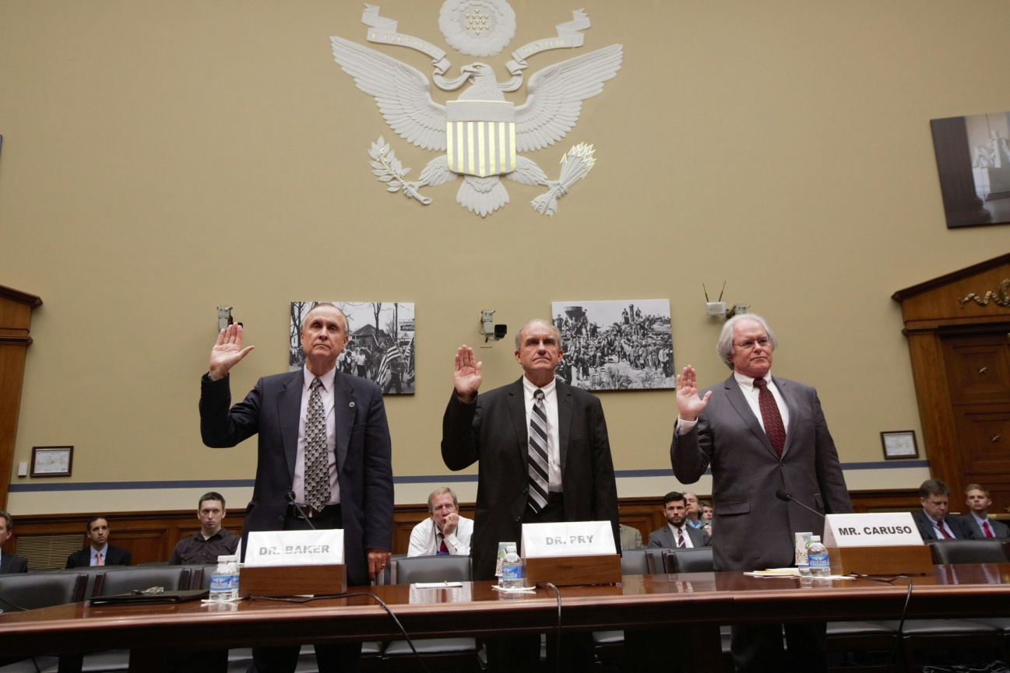
Specifications & Legislation
Michael A. Caruso
HEMP /IEMI Facility Design
Dr. George Baker, Dr. Peter Pry, Michael Caruso Testifying Before U.S. Congress
Photo By Ashton Bingham

Slide 5
Specifications & Legislation
Michael A. Caruso
HEMP /IEMI Facility Design
U.S. Congress:
National Defense Authorization Act for Fiscal Year 2016
Reestablishment of EMP Commission Amendment offered by Rep. Trent Franks
Senate Bill S. 1356
11/25/2015 Became Public Law No: 114-92.
Sec. 1089. Reestablishment of Commission to Assess the Threat to the United States from Electromagnetic Pulse Attack.

Slide 6
Specifications & Legislation
Michael A. Caruso
HEMP /IEMI Facility Design
U.S. Congress:
Action By: House Energy and Commerce
H.R.2244 - To establish a Strategic Transformer Reserve program, and for other purposes
House - Energy and Commerce
05/15/2015 Referred to the Subcommittee on Energy and Power

Slide 7
Specifications & Legislation
Michael A. Caruso
HEMP /IEMI Facility Design
U.S. Congress:
H.R.2402 - Protecting Critical Infrastructure Act (AKA Shield Act)
Rep. Franks, Trent [R-AZ-8] (Introduced 02/25/2015)
House - Energy and Commerce
05/22/2015 Referred to the Subcommittee on Energy and Power

